Slide 1
Wi-Fi Smart Home Control
Controlling home electric devices from your mobile phone
Iyad Kuwatly, Pavankumar Bhujannavar, Shivesh Kumar Sharma
Group Number 3 - Fall 2013
Department of Electrical and Computer Engineering - Wayne State University

Slide 2
Outline
Introduction and Project Idea
Questions for audience
What is Wi-Fi Smart Home Control?
Smart Home Applications
Other features with Internet
Advantages
Presenting Working Model and Video
System building blocks (Top Down Approach)
Android User Interface
Wi-Fi Communications
IP Stack Implementation
Microchip Pic32
Sensors and Actuators

Slide 3
Questions for audience
How many of you have forgot to turn off unnecessary lights before sleeping?
How many of you left unnecessary HVAC heater on in another room while stuck in watching a movie?
How many of you prefer to find the house properly heated when coming back home in winter without paying extra unnecessary energy bills?
How many of you check their mobile phone for important messages at least once every 3 hour?

Slide 4
What is Wifi Smart Home Control?
A new approach to control electric home devices using mobile phone
Control includes the following devices:
House Lights (applied in prototype)
Temperature Sensor (applied in prototype)
HVAC Control (heating, ventilation, and air conditioning)
Smoke (CO) Detectors
Motion Sensors
Water Sensors
Doors/Windows Sensors
Garage Door/Front Door Control
Camera Control

Slide 5
Smart Home Applications

Slide 6
Other features with Internet

Slide 7
Advantages
Save energy
With one device (your smart phone) control all home compatible electric appliances
Comfortable
Improved home safety with home security sensors
Low Cost
Easy installation using wireless communications

Slide 8
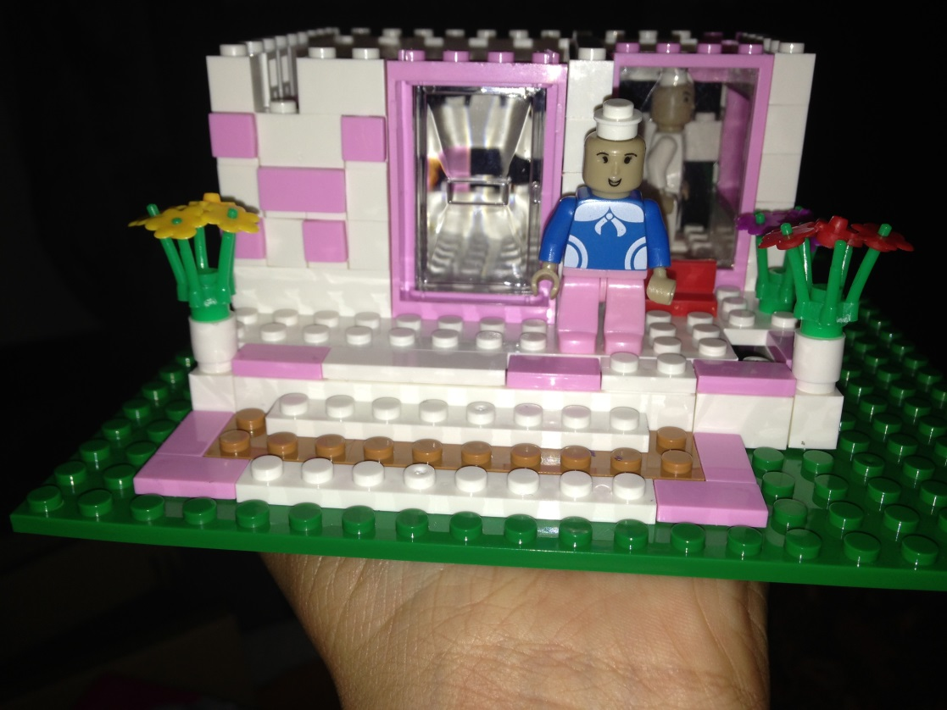
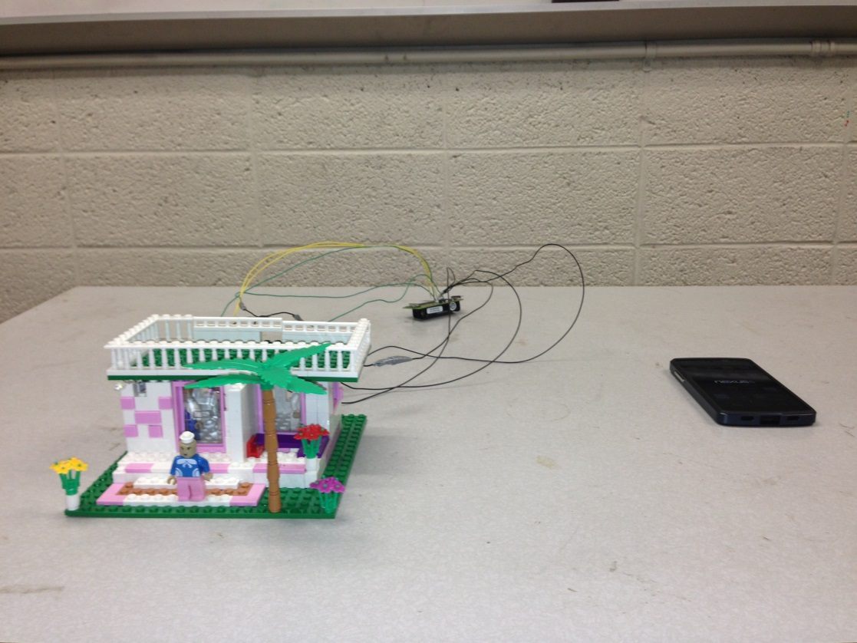
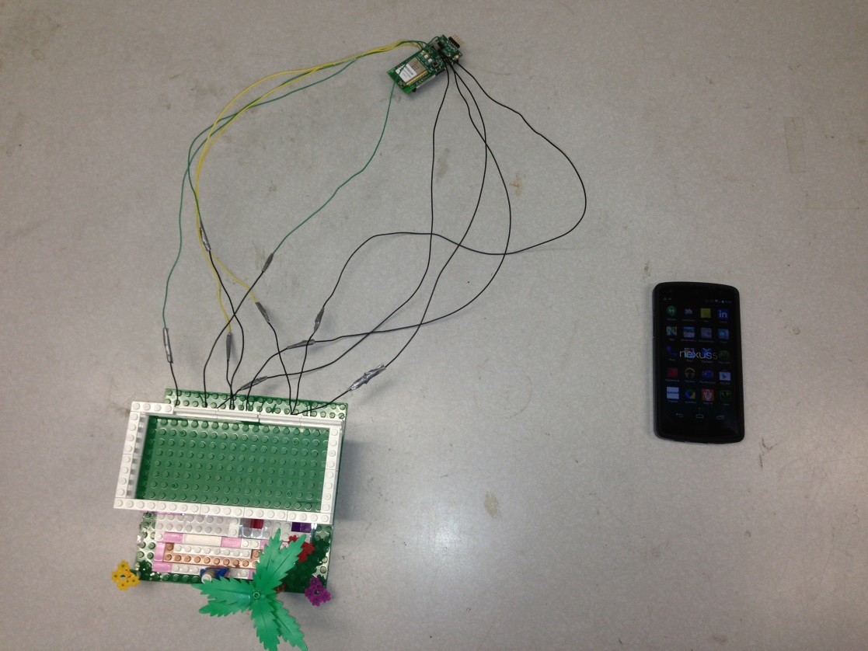

Working Prototype

Slide 9


Slide 10
Building Blocks (Top down)
1- Android App (User Interface)
2- Wi-Fi Communications
3- IP Stack Implementation
4- Pic 32 Controller
5- Sensors and Actuators

Slide 11
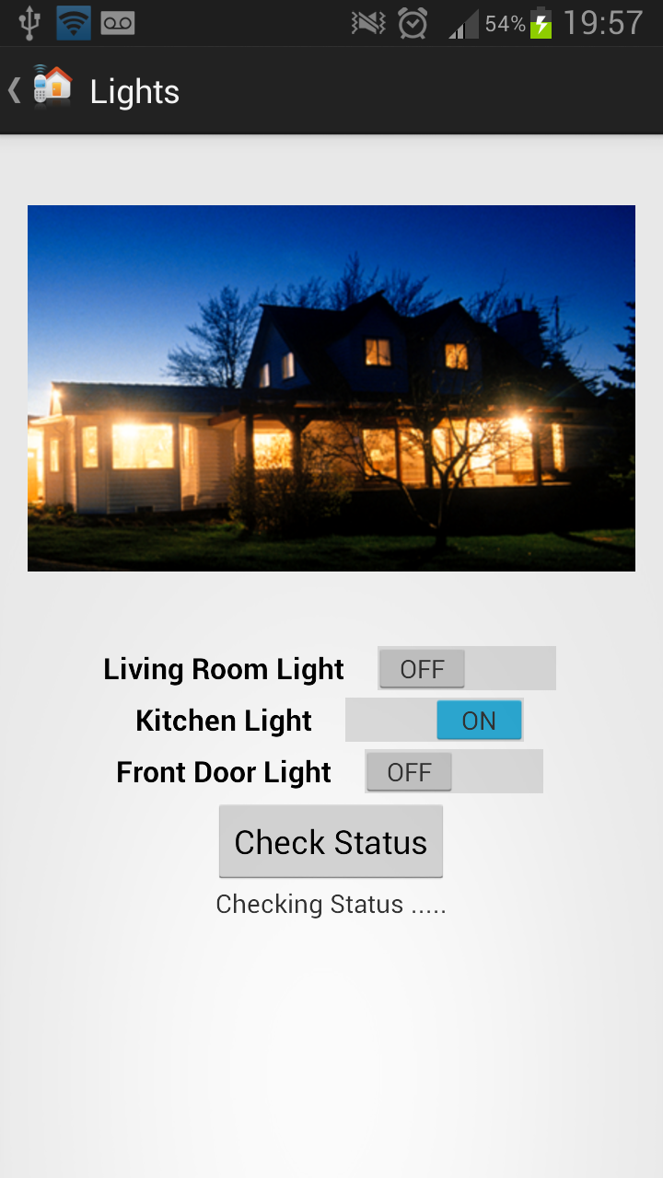
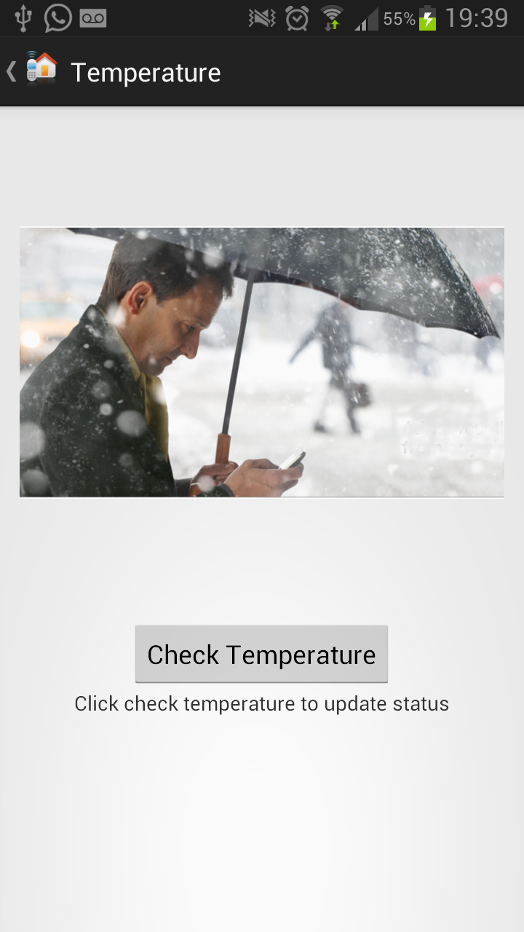
Building Blocks: Android App

Slide 12
Android App Flowchart
User Touch
Handles user touches of buttons on UI
Create Thread
Prepare HTTP request contents
Update User Interface
Upon receiving feedback parse contents
Update UI components to reflect changes
Based on button touch call appropriate function
Create and dispatch a new thread matching user request

Slide 13

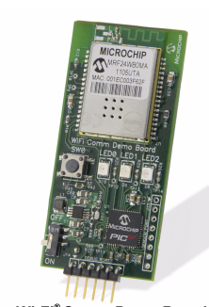

Wi-Fi (Adhoc vs. Infrastructure)
IPhone: Both Adhoc and Infrastructure Modes
Microchip Wi-Fi Controller
Support both Adhoc and InfrastructureModes
Android: Infrastructure Mode Only

Slide 14
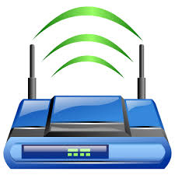

Infrastructure Mode
Wi-Fi Access Point
Android Smart Phone
Microchip Wi-Fi Board

Slide 15

Optional: Internet Expansion
WiFi Access Point
With public IP Address
and optional NAT service
And optional authentication service
Microchip
WiFi Board
Android Smart Phone

Slide 16

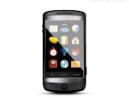
Communication Over Wifi
Request Port Reading
Receive Port Reading
Light
Microchip Wi-Fi Controller
Http Request
XML Status Response
Mobile Phone

Slide 17
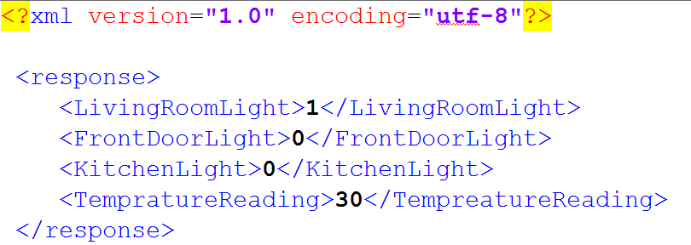
Sample XML Status File

Slide 18
Building Blocks – Wi-Fi Module
Module Name: MRF24WMB0MA RF
Features Summary:
1- IEEE 802.11 b/g/n compatible
2- Data Rate: 1 and 2 Mbps
3- Frequency Used: 2.4Ghz
4- Low Power Consumption and longer battery life
5- Tested Indoor Range: 35m
6- Tested Outdoor Range: 100m
7- Low Cost

Slide 19
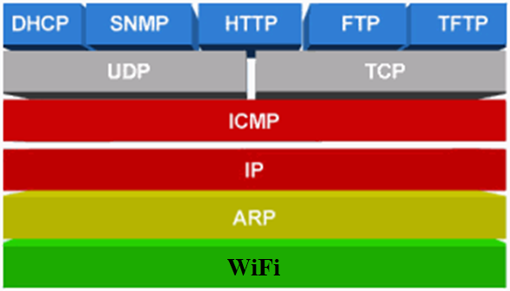
Building Blocks – Microchip IP Stack
Used in Project
Used in Project
Used in Project
Used in Project
Used in Project

Slide 20
IP Stack Flowchart
Initialize IP Stack
Configure the following protocols to run: IP, TCP, HTTP, DHCP
Initialize WiFi Module
Configure MAC, AP SSID, IP and start hardware
Wait User Requests
Loop indefinitely while listening to user requests on IP port 80

Slide 21
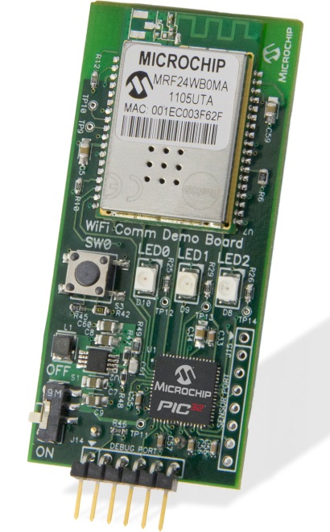
Microchip Pic 32 with WiFi Module
Microchip’s DV102411 Wi-Fi Comm Demo Board:
1- Microchip's 32-bit PIC32 microcontroller family
2- Low-power MRF24WB0MA; IEEE 802.11 and embedded Wi-Fi radio transceiver module.
3- A full-featured TCP/IP stack
4- This board is compact and cost-effective demo board is designed to be easy to integrate with existing embedded designs to evaluate Wi-Fi connectivity and 32-bit performance with minimal effort.

Slide 22
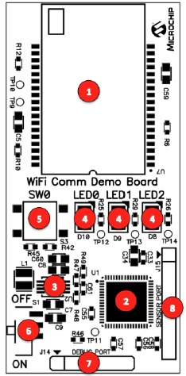
Board Major Components
1. MRF24WMB0MA RF Transceiver module
2. PIC32MX695F512H 32-bit microcontroller
3. MCP1642 +3.3V Boost regulator
4. Three status indicator LEDs
5. One push-button switch for user input
6. Power ON/OFF slider switch
7. 6-pin debug port
8. 8-pin sensor port

Slide 23
Board Major Components
Microchip MRF24WB0MA- RF Transceiver
MRF24WB0MA features:
IEEE Std. 802.11-compliant RF Transceiver
Serialized unique MAC address
Data Rate: 1 and 2Mbps (MRF24WB0MA and MRF24WB0MB resp)
Small size: 21mm x 31mm 36-pin Surface Mount Module
Integrated PCB antenna (MRF24WB0MA)
External antenna option (MRF24WB0MB)
Easy to integrate with other modules
Radio regulation certification for United States (FCC), Canada (IC), Europe (ETSI) and Japan (ARIB)
Designed for use with Microchip microcontroller families (PIC18, PIC24, dsPIC33, and PIC32)
Operational Features
Single operating voltage: 2.7V-3.6V (3.3V typical)
Temperature Range: 0°C to +70°C Commercial
Band 2.400-2.483.5GHz operation
Data Rate - 1000 kbps

Slide 24
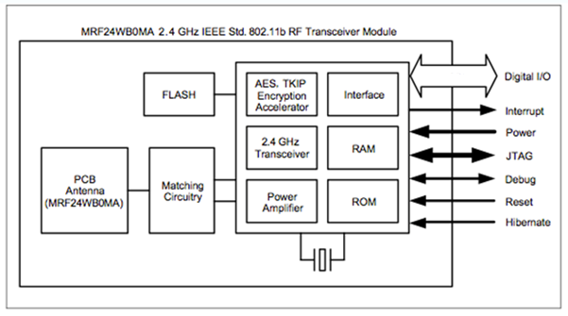
Block diagram representation of RF transreciever module

Slide 25
Board Major Components
Wi-Fi Transceiver: The MRF24WMB0MA RF Transceiver module provides wireless connectivity to the demo board. Host communication is through SPI2 of the PIC processor on the board.
Power Supply: The board is powered through 2 AAA Lithium batteries. If required, the battery voltage is monitored and boosted by the MCP1642 Synchronous Boost Regulator.
Sensor Expansion Port: Connector J15 provides access to some of the processors spare I/O pins. These pins can function as an SPI, UART, or I2C port to an attached sensor board or as general purpose I/O.

Slide 26
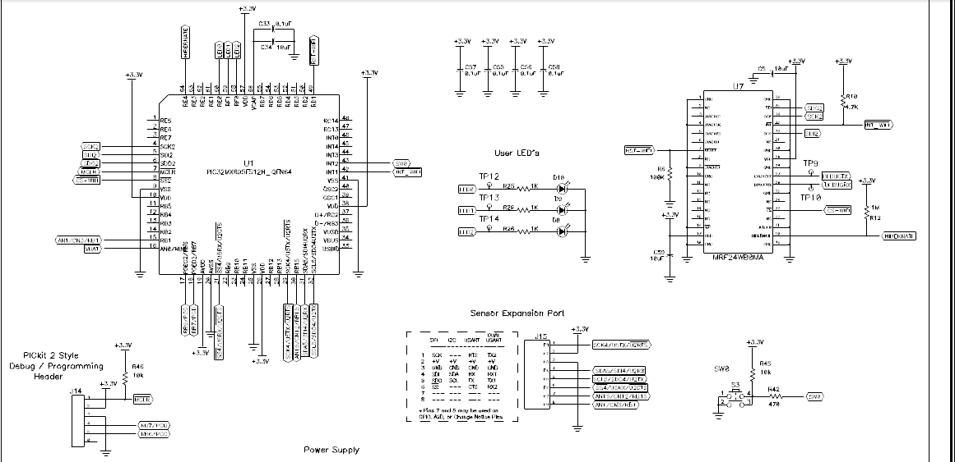
Schematic:

Slide 27
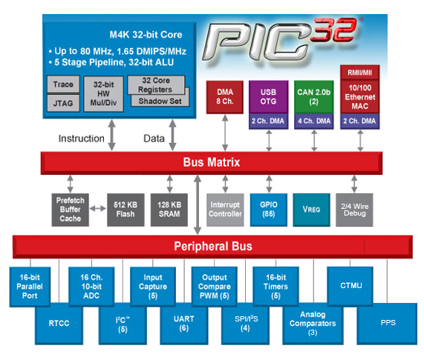
Pic 32 Compenents

Slide 28
PIC32 Microcontroller- PIC Model #: PIC32MX695F512H
PIC32 Microcontroller is chosen to drive the main idea of Project and Wi-Fi Communication
PIC32 features:
5 Stage pipeline, Harvard architecture
Operating Speed of 80MHz
Single cycle multiply and hardware divide unit
32 x 32-bit Core Registers
32 x 32-bit Shadow Registers
Fast context switch and interrupt response
512K Program Memory
128K RAM (can execute from RAM)
Flash prefetch module with 256 Byte cache
Programmable interrupt controller- interrupts can be prioritized
Fast and Accurate 16 channel 10-bit ADC -Max Resolution 10
2 Internal oscillators (8MHz & 31 KHz)
Pin compatible with 16-bit PIC MCUs
Serial Communication Modules allow flexible UART (Universal Asynchronous Receiver/Transmitter- used for serial communication over a computer or peripheral device)/SPI (Serial Peripheral Interface- Devices communicate in master/slave mode where the master device initiates the data frame. Multiple slave devices are allowed to connect with individual slave select lines.)/I2C (Inter-Integrated Circuit configuration - used for attaching low-speed peripherals to a motherboard, embedded system, cell phone or other electronic device)

Slide 29
Pic 32 Program Flowchart
Receive Http Request
Listen on port 80 and call interrupt handler when a request is received
Parse Request Contents
Check if the request is to change an actuator or to check status of sensors
Compile response and send it back
Check port readings and prepare response to the same sender based on IP address
Call appropriate function

Slide 30
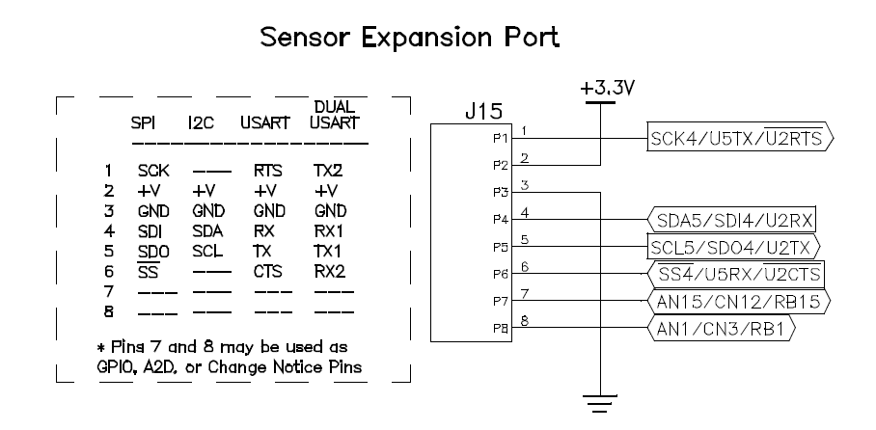
Sensor Expansion Port

Slide 31
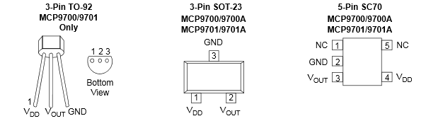
MCP9700- Microchip’s Temperature Sensor
Features
• Analog Temperature Sensor
• Wide Temperature
Measurement Range:
-40°C to +125°C (Extended Temperature)
-40°C to +150°C (High Temperature)
• Accuracy:
- ±2°C (max.), 0°C to +70°C
• Optimized for Analog-to-Digital Converters (ADCs):
- 10.0 mV/°C (typical)
• Wide Operating Voltage Range:
VDD = 2.3V to 5.5V
• Low Operating Current: 6 μA (typical)
• Optimized to Drive Large Capacitive Loads
Typical Applications
• Entertainment Systems
• Home Appliance
• Office Equipment
• General Purpose Temperature Monitoring

Slide 32

Special Thanks to Mr. Yunrui Li

Slide 33
Thank You!

